Slide 1

Students Mark Analysis System
This presentation will outline a comprehensive system for analyzing student marks, providing valuable insights and recommendations to enhance academic performance.
KS

Slide 2

Data Gathering and Storage
Data Sources
Database Management
Marks are collected from various sources like tests, assignments, and projects.
Student information and marks are securely stored in a central database.
Data Integrity
Ensuring accurate data entry and maintaining data consistency are crucial.

Slide 3
C-CODE
#include <stdio.h>
#include <string.h>
#define MAX_STUDENTS 100
#define MAX_SUBJECTS 10
typedef struct { int roll_no; char name[50]; int marks[MAX_SUBJECTS]; int total; float average; int rank; } Student;
void calculateTotalAndAverage(Student* student, int subjects) { student->total = 0; for (int i = 0; i < subjects; i++) { student->total += student->marks[i]; } student->average = (float)student->total / subjects; }
void rankStudents(Student students[], int n) { for (int i = 0; i < n - 1; i++) { for (int j = 0; j < n - i - 1; j++) { if (students[j].total < students[j + 1].total) { Student temp = students[j]; students[j] = students[j + 1]; students[j + 1] = temp;

Slide 4
} } } for (int i = 0; i < n; i++) { students[i].rank = i + 1; }
}
int main() { int num_students, num_subjects; Student students[MAX_STUDENTS];
printf("Enter the number of students: "); scanf("%d", &num_students); printf("Enter the number of subjects: "); scanf("%d", &num_subjects); for (int i = 0; i < num_students; i++) { printf("\nEnter details for student %d:\n", i + 1); printf("Roll number: "); scanf("%d", &students[i].roll_no); printf("Name: "); scanf(" %[^\n]", students[i].name); printf("Enter marks for %d subjects:\n", num_subjects); for (int j = 0; j < num_subjects; j++) { printf("Subject %d: ", j + 1); scanf("%d", &students[i].marks[j]); }

Slide 5
calculateTotalAndAverage(&students[i], num_subjects); }
rankStudents(students, num_students); printf("\nStudent Marks Analysis:\n"); printf("Rank\tRoll No\tName\t\tTotal\tAverage\n"); for (int i = 0; i < num_students; i++) { printf("%d\t%d\t%-15s\t%d\t%.2f\n", students[i].rank, students[i].roll_no, students[i].name, students[i].total, students[i].average); } return 0;
}

Slide 6
INPUT:-
Enter the number of students:3
Enter details for student 1:
Roll number: 101
Name: Alice
Enter marks for 3 subjects:
Subject 1: 85
Subject 2: 90
Subject 3: 88
Enter details for student 2:
Roll number: 102
Name: Bob
Enter marks for 3 subjects:
Subject 1: 70
Subject 2: 75
Subject 3: 80
Enter details for student 3:
Roll number: 103
Name: Charlie
Enter marks for 3 subjects:
Subject 1: 95
Subject 2: 92
Subject 3: 963

Slide 7
OUTPUT:-
Student Marks Analysis:
Rank Roll No Name Total Average
1 103 Charlie 283 94.33
2 101 Alice 263 87.67
3 102 Bob 225 75.00

Slide 8
LOGIC:-
1. Data Representation
Structure (struct):
A Student structure is used to represent each student with attributes: roll number, name, marks array, total marks, average, and rank.
This encapsulates all the data for each student in a single entity for easier management.
2. Input Handling
Input Number of Students and Subjects:
The program starts by asking for the total number of students and subjects.
Input Student Details:
For each student:
Roll number and name are recorded.
Marks for each subject are collected in an array.
3. Total and Average Calculation
Logic:
For each student, the calculateTotalAndAverage function computes:
Total Marks: Sum of marks from all subjects.
Average Marks: Total marks divided by the number of subjects.
Implementation:
Iteration through the marks array of the student to calculate the sum.

Slide 9
4. Ranking StudentsLogic:
Students are ranked based on their total marks, sorted in descending order (highest total marks first).
Sorting uses Bubble Sort, comparing the total field of each student and swapping their positions if needed.
After sorting, ranks are assigned sequentially (highest total gets rank 1, next highest rank 2, etc.).
Implementation:
A nested loop iterates through the array of students.
Comparisons are made using the total attribute, and Student structures are swapped if necessary.
5. Output Formatting
Logic:
After processing, the program displays the results in a tabular format:
Rank
Roll Number
Name
Total Marks
Average Marks
Implementation:
The printf function is used to format the output neatly.
Logical Steps in Pseudocode
1. Get the number of students and subjects.
2. For each student:
a. Input roll number, name, and marks for all subjects.
b. Calculate total and average marks.
3. Sort students based on total marks in descending order.
4. Assign ranks to students after sorting.
5. Display the results in rank order.

Slide 10
PYTHON CODE:-
class Student:
def __init__(self, roll_no, name):
self.roll_no = roll_no
self.name = name
self.marks = []
self.total = 0
self.average = 0.0
self.rank = 0
def input_student_data(num_students, num_subjects):
students = []
for i in range(num_students):
print(f"\nEnter details for student {i + 1}:")
roll_no = int(input("Enter Roll Number: "))
name = input("Enter Name: ")
student = Student(roll_no, name)
print(f"Enter marks for {num_subjects} subjects:")
for j in range(num_subjects):
mark = int(input(f"Subject {j + 1}: "))
student.marks.append(mark)
student.total = sum(student.marks)
student.average = student.total / num_subjects
students.append(student)
return students

Slide 11
def rank_students(students):
students.sort(key=lambda x: x.total, reverse=True)
for i, student in enumerate(students):
student.rank = i + 1
def display_results(students):
print("\nResults:")
print(f"{'Rank':<5}{'Roll No':<10}{'Name':<20}{'Total':<10}{'Average':<10}")
print("-" * 60)
for student in students:
print(f"{student.rank:<5}{student.roll_no:<10}{student.name:<20}{student.total:<10}{student.average:<10.2f}")
def main():
print("Student Marks Analysis System")
num_students = int(input("Enter the number of students: "))
num_subjects = int(input("Enter the number of subjects: "))
students = input_student_data(num_students, num_subjects)
rank_students(students)
display_results(students)
if __name__ == "__main__":
main()

Slide 12
INPUT:-
Student Marks Analysis System
Enter the number of students: 3
Enter the number of subjects: 3
Enter details for student 1:
Enter Roll Number: 101
Enter Name: Alice
Enter marks for 3 subjects:
Subject 1: 85
Subject 2: 90
Subject 3: 88
Enter details for student 2:
Enter Roll Number: 102
Enter Name: Bob
Enter marks for 3 subjects:
Subject 1: 70
Subject 2: 75
Subject 3: 80
Enter details for student 3:
Enter Roll Number: 103
Enter Name: Charlie
Enter marks for 3 subjects:
Subject 1: 95
Subject 2: 92
Subject 3: 96

Slide 13
OUTPUT:-
Results:
Rank Roll No Name Total Average
------------------------------------------------------------
1 103 Charlie 283 94.33
2 101 Alice 263 87.67
3 102 Bob 225 75.00

Slide 14
LOGIC :-
1. Define Data Structure
Use a class (Student) to encapsulate each student's information:
Attributes:
roll_no: The unique roll number of the student.
name: The student's name.
marks: A list to store marks for all subjects.
total: The sum of marks across all subjects.
average: The average marks.
rank: The student's rank based on total marks.
​2. Input Data
Input number of students and number of subjects.
For each student:
Input roll_no and name.
Input marks for all subjects and store them in the marks list.
Compute:
total
=sum of marks
total=sum of marks
average
=total
number of subjects
average= number of subjects
total

Slide 15
3. Compute Ranks
Use a sorting mechanism to order students by their total marks in descending order:
The student with the highest total marks gets rank 1.
The rank is assigned incrementally as the students are iterated post-sorting.
4. Display Results
Output the results in a tabular format:
Columns include: Rank, Roll Number, Name, Total Marks, and Average Marks.
Iterate through the sorted student list and print each student's data.
Program Workflow
Input Stage
Prompt for the total number of students and subjects.
Loop through each student to input their details and calculate total and average marks.
Processing Stage
Sort the student objects based on their total marks in descending order.
Assign ranks to each student in the sorted list.
Output Stage
Display all students' details, including their rank, roll number, name, total marks, and average.

Slide 16
1. Syntax
- C: Requires semicolons (;) and braces ({}) to structure the program.
- Python: Relies on indentation, making it cleaner and more readable.
2. Data Types
- C: Statically typed; every variable needs to have a declared type (e.g., int, float).
- Python: Dynamically typed; types are determined at runtime.
3. Memory Management
- C: Manages memory manually (e.g., malloc, free).
- Python: Memory management is automatic (garbage collector).
4. Input and Output
- C: Uses scanf for input and printf for output.
- Python: Uses input for input and print for output.
LANGUAGE DIFFERENCES BETWEEN C AND PYTHON

Slide 17
5. Collections
- C: Arrays are used for collections but have fixed sizes.
- Python: Lists are used, which are dynamic and more versatile.
6. Functionality
- C: Requires manual calculations, such as finding averages.
- Python: Can use built-in functions or libraries for calculations.
7. Error Handling
- C: Error handling is manual, often requiring checks for invalid inputs.
- Python: Can use try...except for robust error handling.
8. Development Time
- C: Requires more effort due to verbose syntax and manual memory management.
- Python: Faster to develop due to simplicity and built-in features.

Slide 18
PYTHON CODE FOR CHART AND GRAPH:-
import matplotlib.pyplot as plt
students = ["Alice", "Bob", "Charlie"]
total_marks = [450, 490, 420]
average_marks = [90, 98, 84]
ranks = [2, 1, 4]
fig, axes = plt.subplots(2, 1, figsize=(8, 10), gridspec_kw={'hspace': 0.5})
axes[0].bar(students, total_marks, color='skyblue', edgecolor='black’)
axes[0].set_title("Total Marks of Students", fontsize=14, weight='bold’)
axes[0].set_xlabel("Students", fontsize=12)axes[0].set_ylabel("Total Marks", fontsize=12)
axes[0].grid(axis='y', linestyle='--', alpha=0.7)
axes[1].plot(students, average_marks, label="Average Marks", marker='o', color='green', linewidth=2)
axes[1].plot(students, ranks, label="Ranks", marker='s', color='red', linestyle='--', linewidth=2)
axes[1].set_title("Average Marks and Ranks of Students", fontsize=14, weight='bold’)
axes[1].set_xlabel("Students", fontsize=12)
axes[1].set_ylabel("Values", fontsize=12)
axes[1].legend()axes[1].grid(axis='y', linestyle='--', alpha=0.7)
plt.show()

Slide 19
C CODE FOR CHART AND GRAPH:-
include <stdio.h>
int main() {
// Data for Alice, Bob, and Charlie
const char* students[] = {"Alice", "Bob", "Charlie"};
int total_marks[] = {450, 490, 420};
float average_marks[] = {90.0, 98.0, 84.0};
int ranks[] = {2, 1, 4};
// Open file for writing data
FILE* file = fopen("data.txt", "w");
if (file == NULL) {
printf("Error opening file for writing.\n");
return 1;
}
// Write header and data
fprintf(file, "Student TotalMarks AverageMarks Rank\n");
for (int i = 0; i < 3; i++) {
fprintf(file, "%s %d %.2f %d\n", students[i], total_marks[i], average_marks[i], ranks[i]); }
printf("Data exported to 'data.txt'. Use gnuplot or another tool to visualize the data.\n");
fclose(file);
return 0;
}

Slide 20
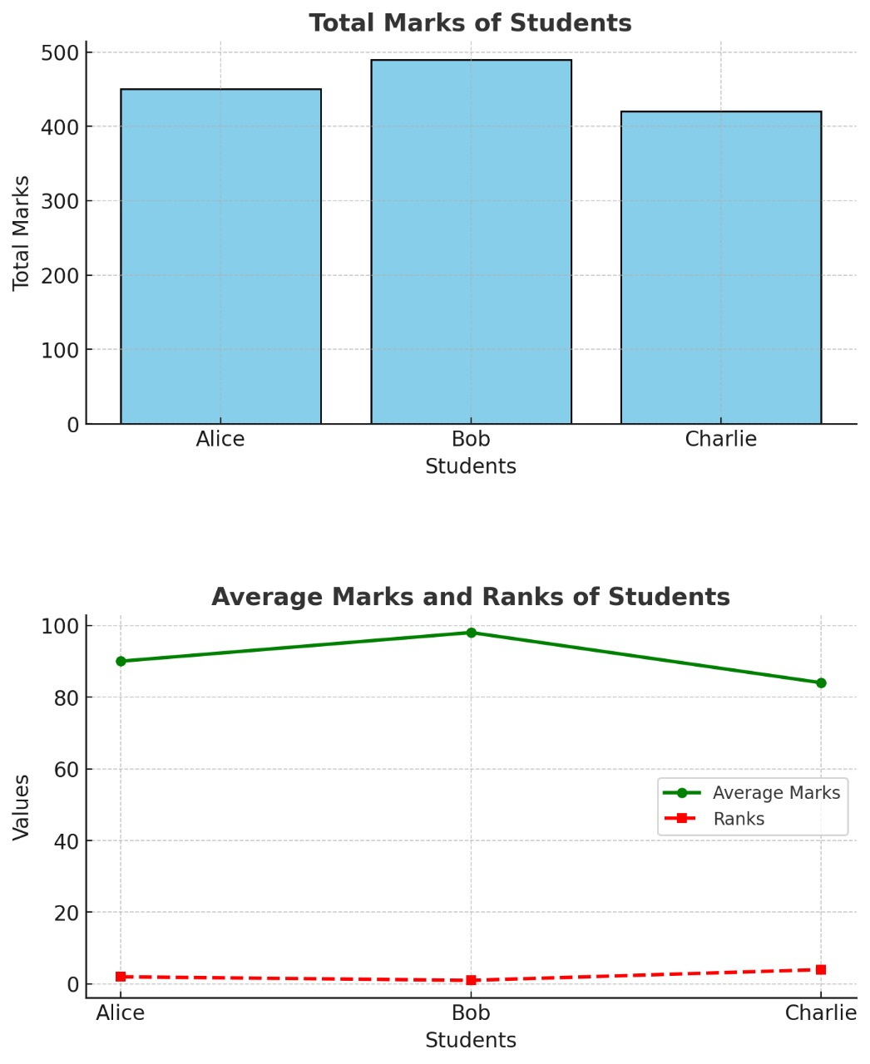

Slide 21
GITHUB LINK
https://github.com/Sambhav96/Student-marks-analysis-system-

Slide 22
CONCLUSION
For a Student Marks Analysis System, Python is the better choice due to its simplicity, readability, and rapid development capabilities. However, if the application needs to run in a constrained environment (e.g., an embedded system), C might be more appropriate.
Python is more beginner-friendly and quicker for high-level tasks, while C offers more control and efficiency for system-level programming
KRISHNA SHUKLA(RA2411003010185)
SAMBHAV SUMAN(RA2411003010190)
ABHISAR(RA2411003010183)

